Slide 1
Section 809 Panel Recommendation Overview
May 29, 2019
Larry Trowel, Commissioner

Slide 2
The Section 809 Panel
Congressionally mandated (FY16 NDAA), independent commission tasked with streamlining and improving defense acquisition process
16 commissioners - senior marketplace and government leaders with more than 300 years of collective experience
A catalyst for restoring agility and simplicity to defense acquisition through bold, simple, and effective solutions
Focused on creating a modern, agile defense acquisition process that provides warfighters what they need, when they need it
“We are a catalyst for restoring agility and simplicity to defense acquisition through bold and effective solutions.”

Slide 3
WHY?
The United States’ ability to maintain technological, military, and economic superiority is being challenged by near-peer competitors and non-state actors that are rapidly gaining on traditional U.S. advantages.
Suffocating bureaucratic requirements are frequently prioritized over mission effectiveness.
Acquisition is too slow to keep pace with today’s rapidly changing technological environment
DoD is an unattractive customer to firms with innovative solutions
Getting capability to the warfighter takes too long
The Panel envisions a modern Defense Acquisition System on a war footing that enables DoD to rapidly buy technologically superior capability for warfighters inside the turn of adversaries.
BOLD.
SIMPLE.
EFFECTIVE.

Slide 4
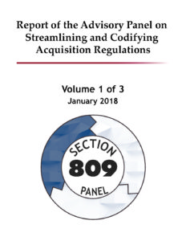
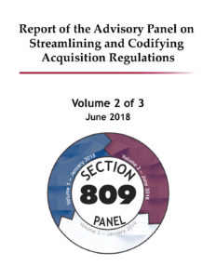
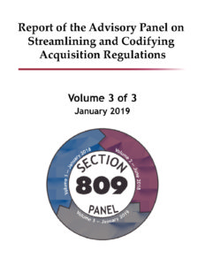
Three Reports - 92 Recommendations
BOLD.
SIMPLE.
EFFECTIVE.
5 recommendations
3 statutory changes enacted in FY18 NDAA
Addressed wide range of acquisition topics
24 recommendations
7 statutory changes enacted in FY19 NDAA
Introduced portfolio management concept
10 recommendations
1 statutory change enacted in FY19 NDAA
Fully describes dynamic marketplace
59 recommendations
Statutory changes pending
Portrays vision for the Defense Acquisition System
Summarizes the Panel’s 98 recommendations
Interim Report
Vol. I Report
Vol. II Report
Vol. III Report
Roadmap
May
2017
Jan
2018
Jul
2018
Jan
2019
Feb
2019

Slide 5
Adapt at the Speed of a Changing World
Promote:
Integrity
Competition
Transparency
Deliver capability/innovation to the warfighter - fast
Move DoD to a war footing – mission first
Place a value on time
Eliminate Barriers - Buy the way buyers and sellers do business

Slide 6
Recommendations - Scope
Small business
Commercial buying
Audit/contract admin
Cost accounting
Services
Streamlining compliance
Portfolio management
IT procurement
Acquisition workforce
Budget
Statutory reporting
Title 10 reorganization

Slide 7
Recommendations - Small Business
Develop DoD strategic plan for the small business program (Rec 21)
Reorganize SADBU and PTAC to align with MIBP
Pivot to focus small business on DOD’s strategic objectives
Enhance SBIR, RIF, SB Technology Transfer (STTR) (Rec 21)
Increase Small Business Innovation Research (SBIR) funding from 3.2% to 7% of DoD extramural R&D funds (Rec 21)
Increase Rapid Innovation Fund (RIF) funding from $250M to $750M (Rec 21)
20% advanced payments to SBs selling commercial (Rec 79)
Permit contract directly with independent SB IT consultants (Rec 45)
BOLD.
SIMPLE.
EFFECTIVE.

Slide 8
Recommendations Impacting Small Business
Commercial products and services (Recs 1, 2, 28, 62)
Raise thresholds for DBA, Walsh Healy, SCA (Rec 65)
Provide redacted source selection briefs (Rec 69)
Revise “Fair Opportunity” for TO/DO (Rec 76)
Role-based security clearances (Rec 77)
Preserve preference for commercial buying (Rec 80)
Establish Market Liaisons (Rec 85)
Enhance Market Research (Rec 86)
BOLD.
SIMPLE.
EFFECTIVE.

Slide 9
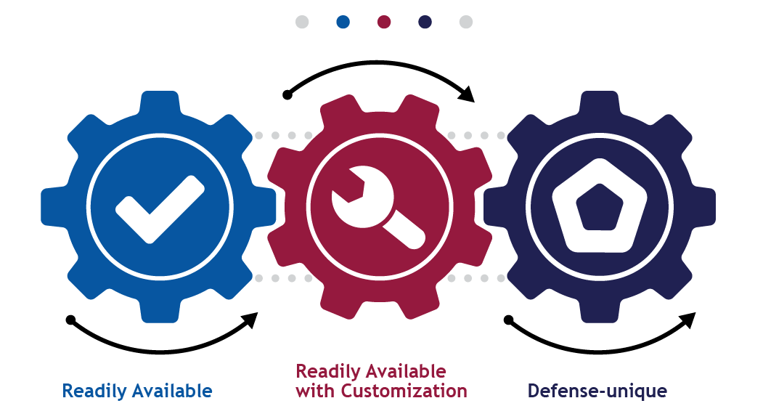
Recommendation - Dynamic Marketplace Framework
A radically simplified way of interacting with the private sector and contracting to leverage the Dynamic Marketplace
BOLD.
SIMPLE.
EFFECTIVE.

Slide 10
Dynamic Marketplace Framework - Readily Available & with Customization
Bold recommendation (Rec 35)
Products & services
Transparent market-based pricing, terms, and competition
Simplified procedures
Rapid delivery
Typically multiple sources
Limited procurement laws/policies apply
No cost type
No change to SB goals
No mandatory set-aside
5% price preference for SB
BOLD.
SIMPLE.
EFFECTIVE.

Slide 11
The Way Ahead
Reports are done…but work continues
Panel will advocate for implementation of its recommendations with Congress, DoD, and other stakeholders
Reforming culture is the beginning, end, and center of defense acquisition reform
Culture change must be led from the top
BUT…everyone can be a change champion!
BOLD.
SIMPLE.
EFFECTIVE.

Slide 12
Learn more on our website
@Section809Panel
www.section809panel.org

